Slide 1

Broadband Solutions

Slide 2
Design efficient networked systems
Bandwidth:
Expected average load; anticipated peak load; local internet availability; cost constraints, throughput.

Slide 3
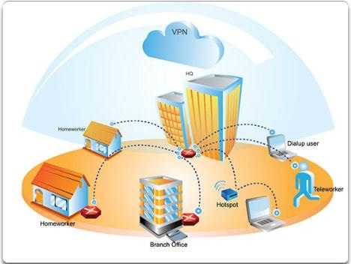
Connecting Networks

Slide 4
▪ Determine how to select broadband solutions to support remote
connectivity in a small-to-medium-sized business network.
▪ Describe a cable system and cable broadband access.
▪ Describe a DSL system and DSL broadband access.
▪ Describe broadband wireless options.
▪ Compare broadband solutions.
▪ Configure and verify a basic Point-to-Point Protocol (PPP) over
Ethernet connection on a client router.

Slide 5
Comparing Broadband Solutions

Slide 6
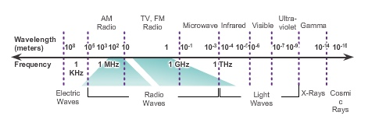
Cable and the Electromagnetic Spectrum

Slide 7
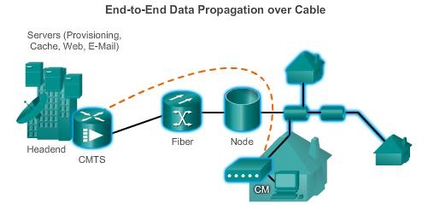
Cable Components
Two types of equipment required to send digital modem signals
upstream and downstream on a cable system:
▪ Cable Modem Termination System (CMTS) at the headend of the
cable operator.
▪ Cable modem (CM) on the subscriber end.

Slide 8
DSL
▪ DSL provides high-speed connections over installed copper wire
system.
▪ Two basic types of DSL technologies are asymmetric (ADSL) and
symmetric (SDSL).
▪ ADSL uses a frequency range from approximately
20 kHz to 1 MHz.
▪ ADSL provides higher downstream bandwidth to the user than
upload bandwidth.
▪ SDSL provides the same capacity in both directions.
▪ Local loop must be less than approximately 3.39 mi. (5.46 km) for
ADSL.

Slide 9
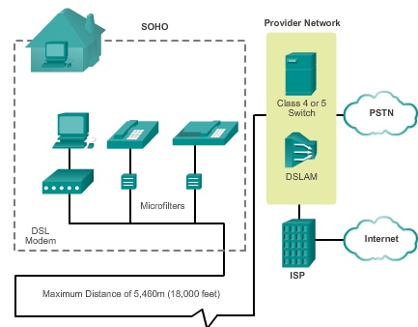
DSL Connections
Two key components required
to provide a DSL connection:
▪ Transceiver – Connects the
computer of the teleworker to
the DSL.
▪ DSL access multiplexer
(DSLAM) – Located at the
carrier’s central office, it
combines individual DSL
connections from users into
one high-capacity link to an
ISP.

Slide 10

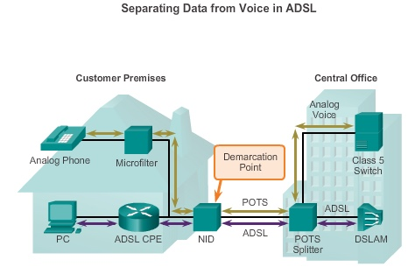
Separating Voice and Data in ADSL

Slide 11
Broadband Wireless Technology Types
▪ Municipal Wi-Fi (Mesh)
▪ Worldwide Interoperability for Microwave Access (WiMAX)
• A single WiMAX tower can provide coverage to an area as
large as 3,000 square miles.
• A WiMAX receiver similar in size and shape to a PCMCIA
card, or built into a laptop or other wireless device.

Slide 12
Broadband Wireless Technology Types
▪ Cellular/mobile implementations wireless Internet:
• 3G/4G Wireless: Third generation and fourth generation wireless.
• Long-Term Evolution (LTE): A newer and faster technology
considered to be part of the 4G technology.
▪ Satellite Implementations
• one-way multicast
• one-way terrestrial return
• two-way satellite Internet

Slide 13
Selecting Broadband Solutions
Comparing Broadband Solutions
▪ Cable – Bandwidth is shared by many users.
▪ DSL – Limited bandwidth that is distance-sensitive.
▪ Fiber-to-the-Home – Requires fiber-access network overlay.
▪ Cellular/Mobile – Coverage is often an issue, bandwidth relatively
limited.
▪ Wi-Fi Mesh – Many municipalities do not have a mesh network
deployed.
▪ WiMAX – Bit rate is limited to 2 Mb/s per subscriber; cell size is 1.25
miles (1 to 2 km.)
▪ Satellite – Expensive; limited capacity per subscriber.

Slide 14
Configuring xDSL

Slide 15
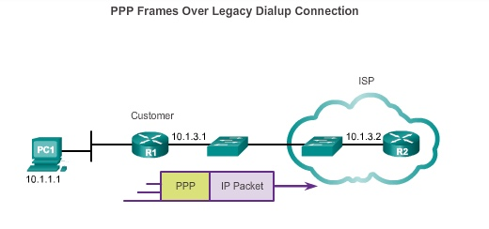
PPPoE Overview
PPPoE Motivation
▪ Most commonly used data link layer protocol by ISPs is PPP.
▪ The PPP over Ethernet (PPPoE) protocol allows the transmission of
PPP frames encapsulated inside Ethernet frames.

Slide 16
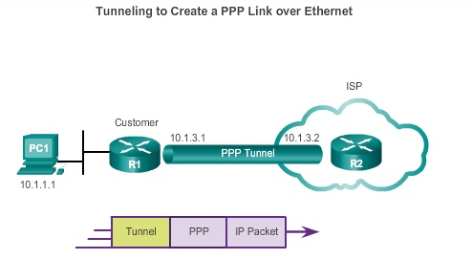
PPPoE Overview
PPPoE Concepts

Slide 17
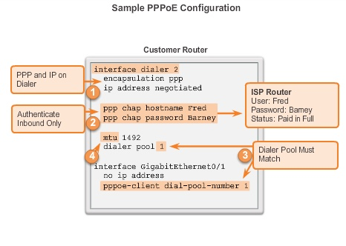
Configuring PPP0E
PPPoE Configuration

Slide 18
Summary
This chapter:
▪ Explored the various broadband solutions used by telecommuters
and branch office workers.
▪ Outlined the features and basic infrastructure behind each
broadband technology, which enables a network manager to make
an informed selection.
▪ Identified DSL, cable, and broadband wireless options as the various
broadband solutions.
▪ Described basic DSL configuration.

Slide 19
Networking services and applications:

Slide 20
DHCP Static Vs Dynamic IP Addressing(DNS servers)
DHCP relays
Routing & Switching

Slide 21
Dynamic Host
Configuration Protocol v4

Slide 22
DHCPv4 Operation
Introducing DHCPv4
DHCPv4 uses three different address allocation methods:
▪ Manual Allocation – The administrator assigns a pre-allocated IPv4
address to the client, and DHCPv4 communicates only the IPv4
address to the device.
▪ Automatic Allocation – DHCPv4 automatically assigns a static IPv4
address permanently to a device, selecting it from a pool of available
addresses.
▪ Dynamic Allocation – DHCPv4 dynamically assigns, or leases, an
IPv4 address from a pool of addresses for a limited period of time
chosen by the server, or until the client no longer needs the address.
This method is the most commonly used.

Slide 23
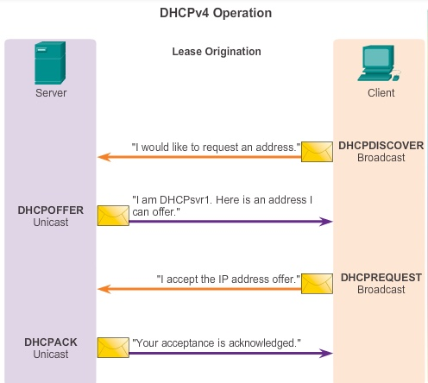
DHCPv4 Operation
DHCPv4 Operation

Slide 24
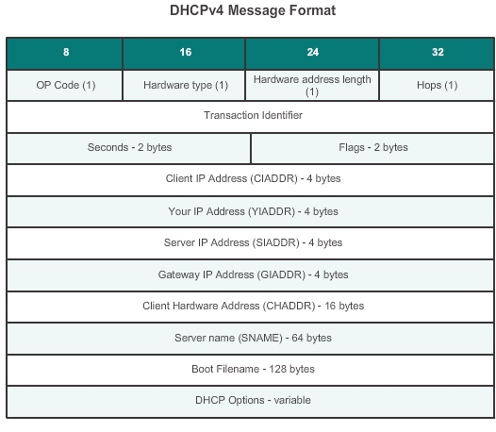
DHCPv4 Operation
DHCPv4 Message Format

Slide 25
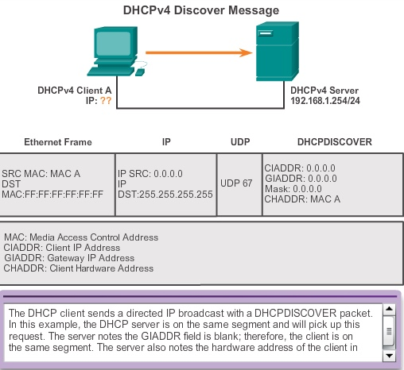
DHCPv4 Operation
Format DHCPv4 Discover and Offer Messages

Slide 26
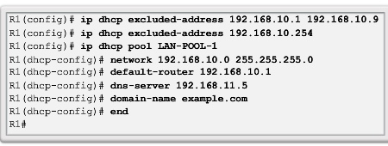
DHCPv4 Operation
Configuring a DHCPv4 Server
A Cisco router running the Cisco IOS software can be configured to act
as a DHCPv4 server. To set up DHCP:
1. Exclude addresses from the pool.
2. Set up the DHCP pool name.
3. Define the range of addresses and subnet mask. Use the
default-router command for the default gateway. Optional
parameters that can be included in the pool – dns server,
domain-name.
To disable DHCP, use the no service dhcp command.

Slide 27
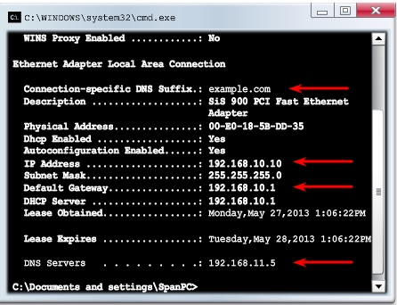
DHCPv4 Operation
Verifying a DHCPv4 Server
▪ Commands to verify DHCP:
show running-config | section dhcp
show ip dhcp binding
show ip dhcp server statistics
▪ On the PC, issue the ipconfig /all command.

Slide 28
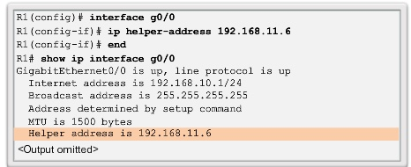
DHCPv4 Operation
DHCPv4 Relay
Using an IP helper address enables a router to forward DHCPv4
broadcasts to the DHCPv4 server. Acting as a relay.

Slide 29
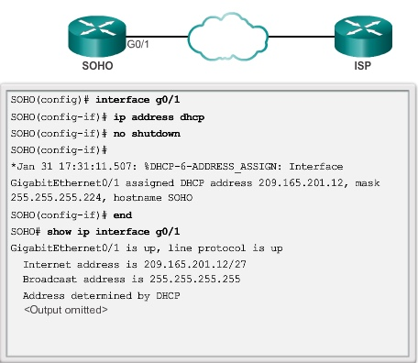
Configuring a DHCPv4 Client
Configuring a Router as a DHCPv4 Client

Slide 30
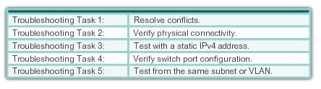
Troubleshoot DHCPv4
Troubleshooting Tasks

Slide 31
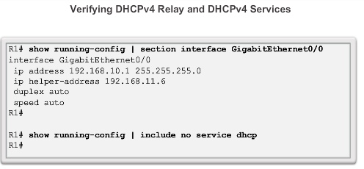
Troubleshoot DHCPv4
Verifying the Router DHCPv4
Configuration

Slide 32
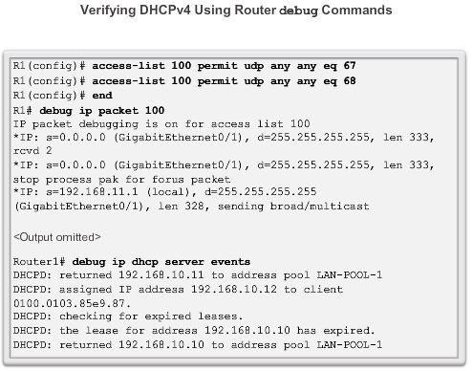
Troubleshoot DHCPv4
Debugging DHCPv4

Slide 33
Dynamic Host
Configuration Protocol v6

Slide 34
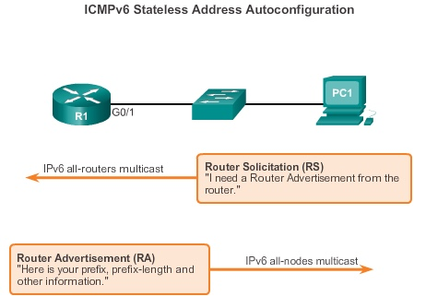
SLAAC and DHCPv6
Stateless Address Autoconfiguration
Stateless Address Autoconfiguration (SLAAC) is a method in which a
device can obtain an IPv6 global unicast address without the services
of a DHCPv6 server.

Slide 35
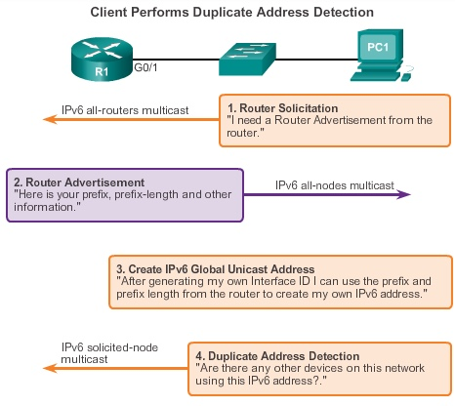
SLAAC and DHCPv6
SLAAC Operation

Slide 36
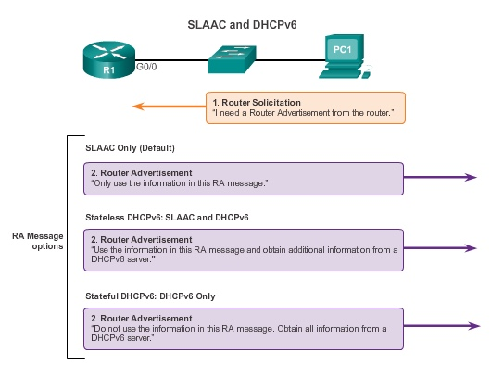
SLAAC and DHCPv6
SLAAC and DHCPv6

Slide 37
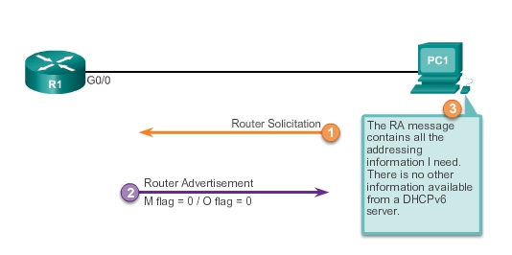
SLAAC and DHCPv6
SLAAC Option

Slide 38
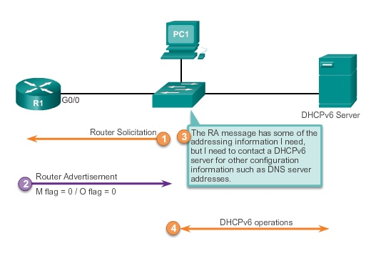
SLAAC and DHCPv6
Stateless DHCP Option

Slide 39
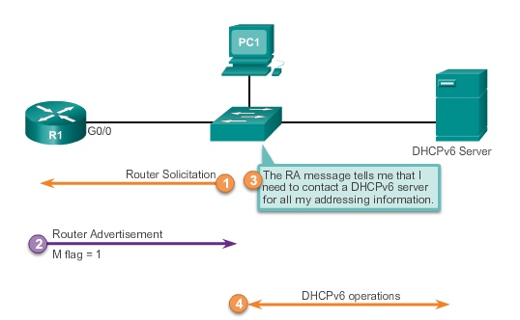
SLAAC and DHCPv6
Stateful DHCP Option

Slide 40
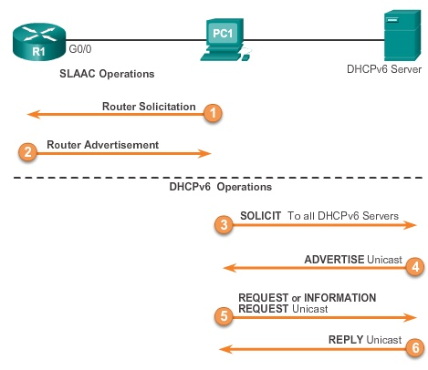
SLAAC and DHCPv6
DHCPv6 Operations

Slide 41
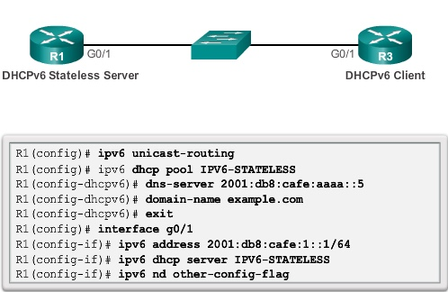
Stateless DHCPv6
Configuring a Router as a Stateless
DHCPv6 Server

Slide 42
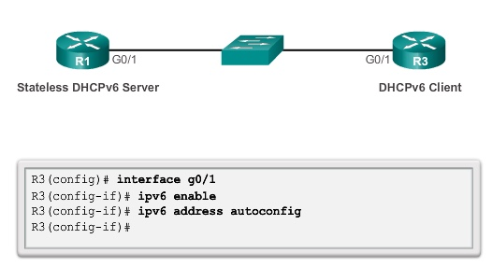
Stateless DHCPv6
Configuring a Router as a Stateless
DHCPv6 Client

Slide 43
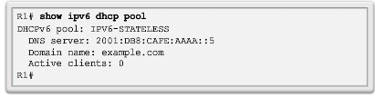
Stateless DHCPv6
Verifying Stateless DHCPv6
Verify the stateless DHCP client using the following commands:
▪show IPv6 interface
▪debug ipv6 dhcp detail

Slide 44
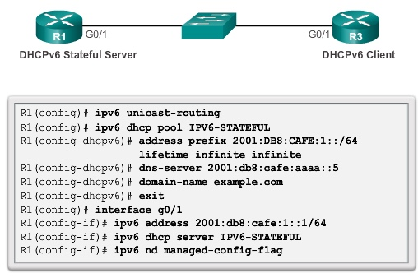
Stateful DHCPv6
Configuring a Router as a Stateful DHCPv6
Server

Slide 45
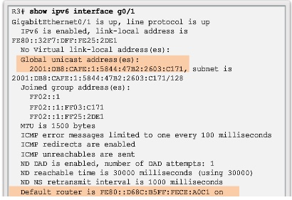
Stateful DHCPv6
Verifying Stateful DHCPv6
▪ Verify the stateful DHCPv6 server using the following commands:
show ipv6 dhcp pool
show ipv6 dhcp binding
▪ Verify the stateful DHCPv6 client using the show ipv6
interface command.

Slide 46
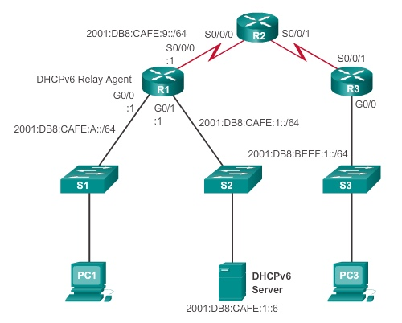
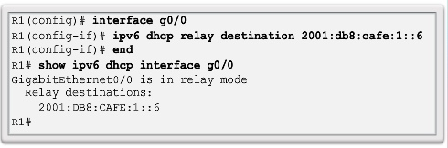
Stateful DHCPv6
Configuring a Router as a Stateful DHCPv6
Relay Agent

Slide 47
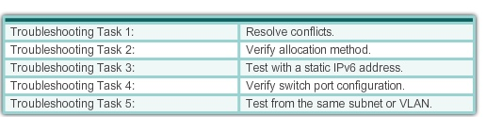
Troubleshooting DHCPv6
Troubleshooting Tasks

Slide 48
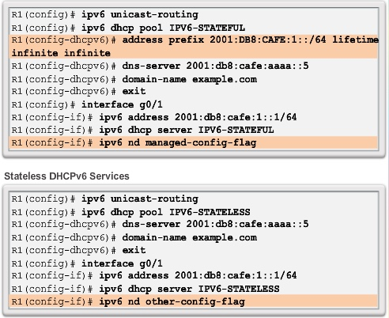
Troubleshooting DHCPv6
Verifying the Router DHCPv6 Configuration

Slide 49
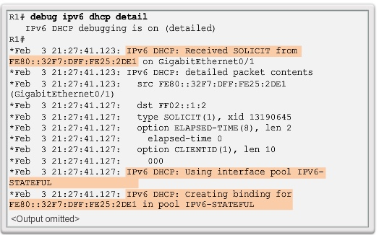
Troubleshooting DHCPv6
Debugging DHCPv6

Slide 50
Summary
▪ All nodes on a network require a unique IP address to communicate
with other devices.
▪ DHCPv4 includes three different address allocation methods:
Manual Allocation
Automatic Allocation
Dynamic Allocation
▪ There are two methods available for the dynamic configuration of
IPv6 global unicast addresses:
Stateless Address Autoconfiguration (SLAAC)
Dynamic Host Configuration Protocol for IPv6 (Stateful
DHCPv6)

Slide 51
Summary (cont.)
The same tasks are involved when troubleshooting DHCPv4 and
DHCPv6:
▪ Resolve address conflicts.
▪ Verify physical connectivity.
▪ Test connectivity using a static IP address.
▪ Verify the switch port configuration.
▪ Test the operation on the same subnet or VLAN.

Slide 52
Communications:
Suited to devices, suited to users, supportive of lifestyle desires, supportive of commercial requirements, security requirements, quality of service needs.

Slide 53
Scalable:
Able to support device growth, able to support addition of communication devices, able to cope with bandwidth use and trend changes, protocol utilisation, addressing.

Slide 54
Selection of components:
Supporting infrastructure needs; supporting connectivity requirements

Slide 55
Summary - I
Topology is a pattern of network devices and describes the way in which these devices are connected.
Physical topology refers to the actual physical structure of the network, while a logical topology determines the way in which the data actually passes through the network from one device to other.
Different types of topologies are Star, Bus, Ring, Mesh, Tree and Hybrid
Bus topology connects each device to a single cable and at either end of the cable terminator is used to remove unsent data from the cable

Slide 56
Summary - II
In star topology, multiple devices are connected to a central connection point known as hub or switch
In a ring topology, data travels around the loop in one direction and passes through each device
In a mesh topology, every device is connected to each and every node in the network with many redundant interconnections and at least two paths to and from every node
Tree topology connects multiple star networks to other star networks using bus topology.
Hybrid topology is a combination of two or more different topologies.

Slide 57
LAB
Run Chapter 3 Lab Exercise

